Slide 1
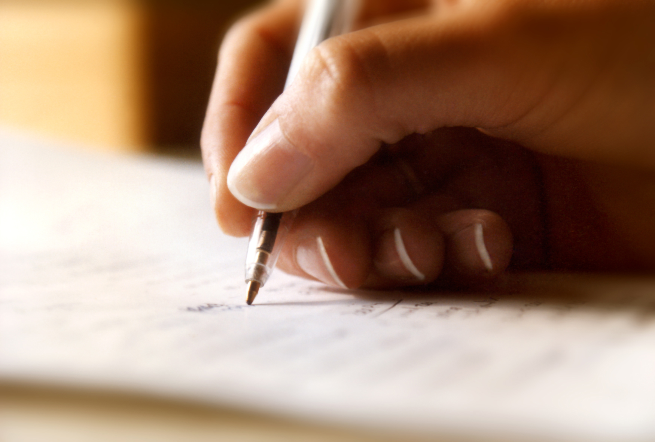
Developing Better Writing:
Geoff Barton

Slide 2
Developing Better Writing:
Geoff Barton

Slide 3
8 Things we know about writing …
Problem of perception: writing = work
Talk matters
Composition counts
Reading feeds writing
Complexity is important but be careful
Narrative dominates
Vocabulary matters
Writing helps us to know ourselves

Slide 4
Demo

Slide 5
Write a newspaper article saying why school uniform is a good thing

Slide 6
Grabbing attention
Sentence variety & functions
Impersonal style

Slide 7
Bad Model

Slide 8
I think school uniform is a really good idea because it makes pupils in school behave better. This is because it creates a positive image of the school and the pupils feel proud of being there ….

Slide 9
Good Models

Slide 10
FBI snitch Ronnie Reagan was a US President who disastrously believed greed was good.
Inequality spiralled out of control, ordinary Americans picking up the tab for an elite partying like never before.
Never the brightest, Reagan nearly bankrupted America with a Star Wars obsession. He sent arms to Osama bin Laden’s fighters in Afghanistan. Thousands of Nicaraguans died from illegal arming of Contra rebels.
The US invaded Grenada in the Caribbean, part of the ­Commonwealth, and used British bases to bomb Libya.
Rabid Ronnie’s new statue in London is good only for pigeons seeking somewhere to poop.

Slide 11
We are going through a period of mourning in our house.
No-one’s died, although I gather Professor Snape snuffs it in Harry Potter and the Deathly Hallows Part 2, the last…sniff…HP movie…sniff, sniff… EVER …sniff, sniff, sniff.
The long goodbye, the lurking inevitability life is about to change for good has been with us since the final scene of Deathly Hallows Part 1, last year. And now, come opening day on July 15 – or the 18th in our case, because, to my sons’ horror, I didn’t book tickets until Thursday this week – the beginning of the end is upon us. Once the final frame has flickered and Harry, Ron and Hermione step in to movie legend, where once we had the next movie to look forward to, all that will be left is a vacuum.

Slide 12
For your next holiday, why don’t you take all your money and put it on the fire? Then stand in a fridge for a week, beating your children with a baseball bat until their arms and legs break. And then, after you’ve eaten some melted cheese, dislocate your shoulder.
If all of this appeals then you are probably one of the 1.3 million British people …
… who go on a skiing holiday at this time of year.

Slide 13
Write a newspaper article saying why school uniform is a good thing

Slide 14
Grabbing attention
Sentence variety & functions
Impersonal style

Slide 15
Developing Better Writing:
Geoff Barton

